Slide 1
Name:- Yash Rajendra Gaikwad
Data Analytics Trainee
Project 3:- Operation Analytics and Investigating Metric Spike
Software Used:- My SQL Workbench 8.0 CE
Case Study 1 : Job Data
Number of jobs reviewed:- Amount of jobs reviewed over time.
Your task: Calculate the number of jobs reviewed per hour per day for November 2020?
B. Throughput:- It is the no. of events happening per second.
Your task: Let’s say the above metric is called throughput. Calculate 7 day rolling average of throughput?
For throughput, do you prefer daily metric or 7-day rolling and why?
C. Percentage share of each language:- Share of each language for different contents.
Your task: Calculate the percentage share of each language in the last 30 days?
D. Duplicate rows:- Rows that have the same value present in them.
Your task: Let’s say you see some duplicate rows in the data. How will you display duplicates from table?
display duplicates from the table?

Slide 2
Case Study 2: Investigating metric spike
A. User Engagement: To measure the activeness of a user. Measuring if the user finds quality in a product/service.
Your task: Calculate the weekly user engagement?
B. User Growth: Amount of users growing over time for a product.
Your task: Calculate the user growth for product?
C. Weekly Retention: Users getting retained weekly after signing-up for a product.
Your task: Calculate the weekly retention of users-sign up cohort?
D. Weekly Engagement: To measure the activeness of a user. Measuring if the user finds quality in a product/service weekly.
Your task: Calculate the weekly engagement per device?
E. Email Engagement: Users engaging with the email service.
Your task: Calculate the email engagement metrics?

Slide 3
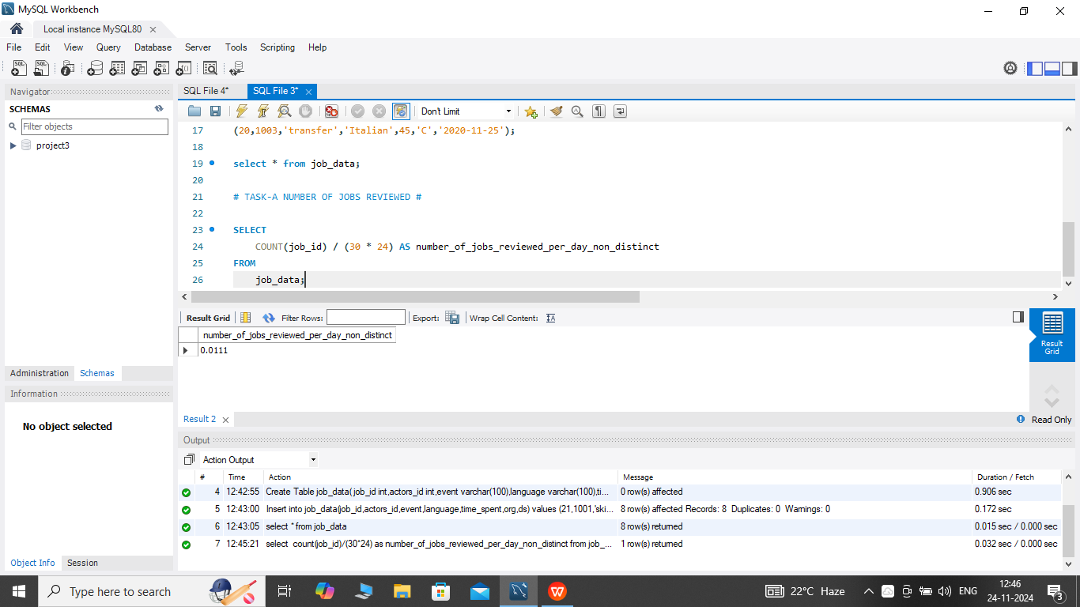
Case Study 1 : Job Data
Number of jobs reviewed:- Amount of jobs reviewed over time.
Your task:- Calculate the number of jobs reviewed per hour per day for November 2020?
Process:-
We will use the data from job_id columns of the job_data table.
Then we will divide the total count of job_id (distinct and non-distinct) by
(30 days * 24 hours)for finding the number of jobs reviewed per day.
Query & Result:-The number of jobs reviewed per hours per day for november 2020 is 0.01.

Slide 4
B. Throughput:- It is the no. of events happening per second.
Your task:- Let’s say the above metric is called throughput. Calculate 7 day rolling average of throughput?
For throughput, do you prefer daily metric or 7-day rolling and why?
Process:-
For calculating the throughput we will be using the 7-day rolling because 7-day rolling gives us the average for all the days right from day 1 to day 7 Whereas daily metric gives us average for only that particular day itself.
We will be first taking the count of job_id(distinct and non-distinct) and ordering them w.r.t ds (date of interview).
Then by using the ROW function we will be considering the rows between 6 preceding rows and the current row.
Then we will be taking the average of the jobs_reviewed.

Slide 5
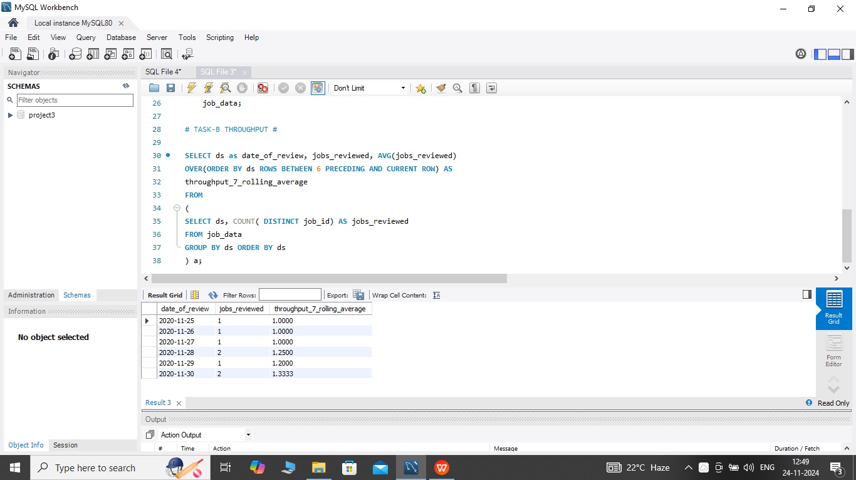
Query & Result:-

Slide 6
C. Percentage share of each language:- Share of each language for different contents.
Your task: Calculate the percentage share of each language in the last 30 days?
Process:-
First we select the job_id, language and we use Count function for language.
We name it as total_of_each_language.
Then divide the total number of languages (distinct/non-distinct) by the total number of rows presents in the table.
Name it as percentage_share_of_each_language.
Then we will do the grouping based on the languages.

Slide 7
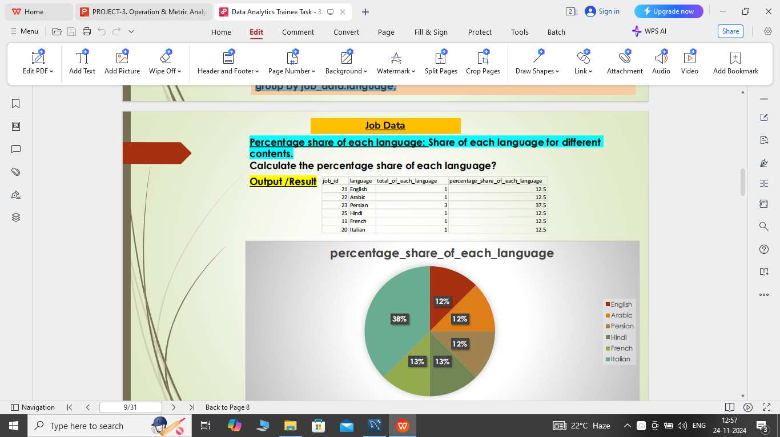
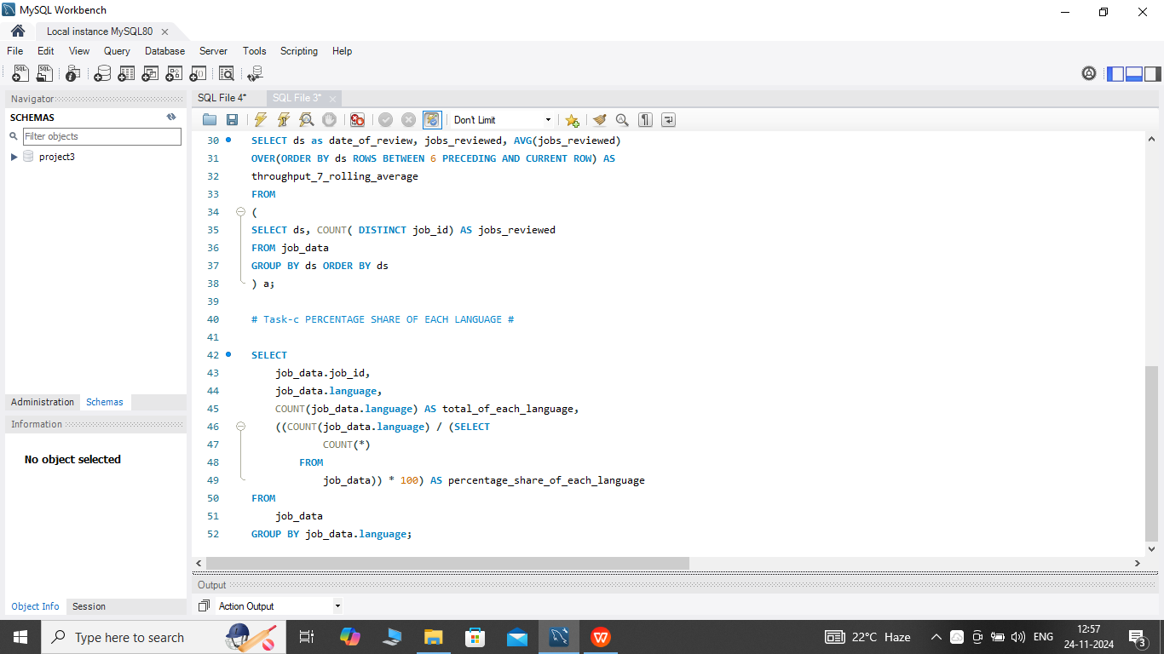
Query & Result:- The Percentage share of each language in 30 days is given in the table.

Slide 8
D. Duplicate rows:- Rows that have the same value present in them.
Your task: Let’s say you see some duplicate rows in the data. How will you display duplicates from table?
display duplicates from the table?
Process:-
First decide in which do we need to find the duplicate row values
After deciding the column(parameter) we will use the ROW_NUMBER function to find the row numbers having the same value
Then we will portioning the ROW_NUMBER function over the column (parameter) that we decided i.e. job_id
Then using the WHERE function we will find the row_num having value greater than 1 i.e. row_num > 1 based on the occurrence of the job_id in the table.

Slide 9
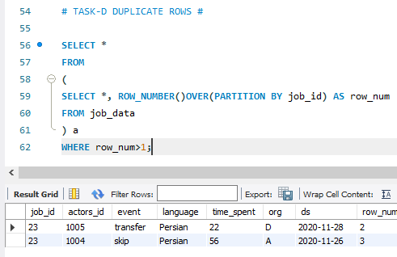
Query & Result:- There are two duplicate rows that have the same value present in them.

Slide 10
Case Study 2: Investigating metric spike
A. User Engagement: To measure the activeness of a user. Measuring if the user finds quality in a product/service.
Your task: Calculate the weekly user engagement?
Process:-
We will extract the week from the occurred_at column of the events table using the EXTRACT function and WEEK function.
Then we will be counting the number of distinct user_id from the events table.
Then we will use the GROUP BY function to group the output w.r.t week from occurred_at.

Slide 11
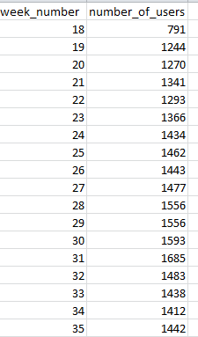
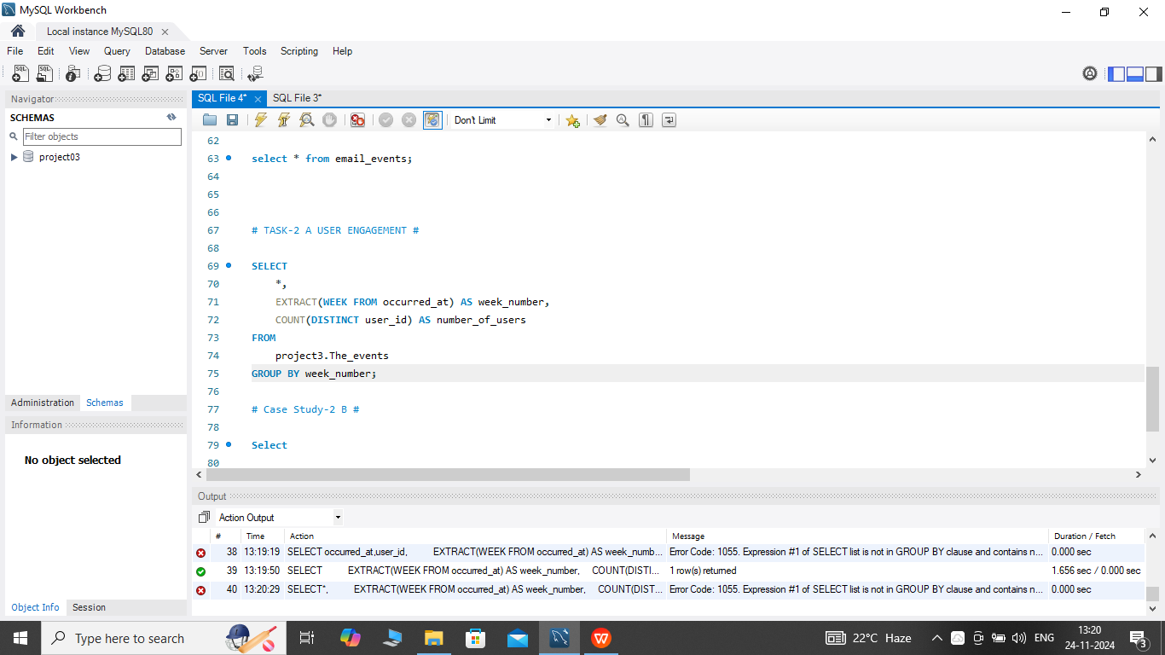
Query & Result:- The weekly user engagement is given in the table.

Slide 12
B. User Growth:- Amount of users growing over time for a product.
Your task: Calculate the user growth for product?
Process:-
First we will the extract the year and week for the occurred_at column of the users table using the extract, year and week functions.
Then we will group the extracted week and year on the basis of year and week number.
Then we ordered the result on the basis of year and week number.
Then we will find the cumm_active_users using the SUM, OVER and ROW function between unbounded preceding and current row.

Slide 13
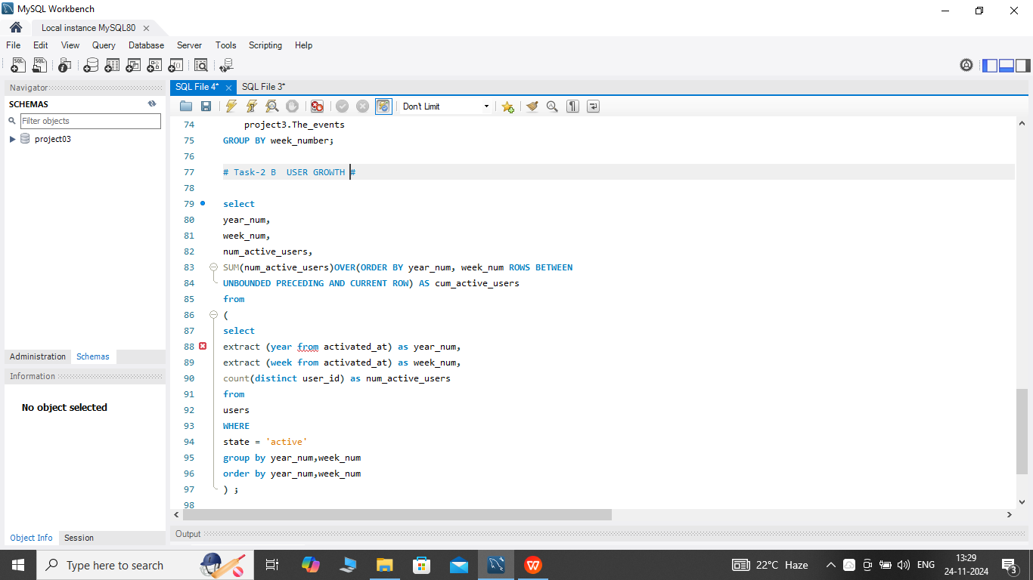
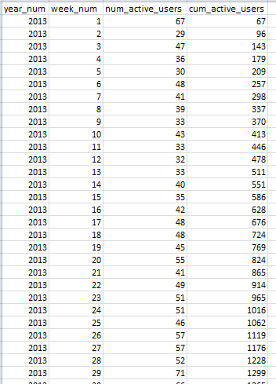
Query & Result:- Hence,There are total 9381 active users. The table shows some active users.

Slide 14
C. Weekly Retention:- Users getting retained weekly after signing-up for a product.
Your task: Calculate the weekly retention of users-sign up cohort?
Process:-
We can calculate the weekly retention of users-sign up cohort by two means i.e. either by specifying the week number or for the entire column of occurred_at of the events table.
In this case we have not given specific weeks so we calculate for the entire column of occurred_at of event table.
Firstly we will extract the week from occurred_at column using the extract,weekfunctions.
Then, we will select out those rows in which event_type = 'signup_flow’ and event_name = 'complete_signup’.
If finding for a spectifc week we will spectify the week number using the extract function.
Then using the left join we will join the two tables on the basis of user_id where event_type = 'engagement’ .
Then we will use the Group By function to group the output table on the basis of user_id.
Then we will use the Order By function to order the result table on the basis of user_id.

Slide 15
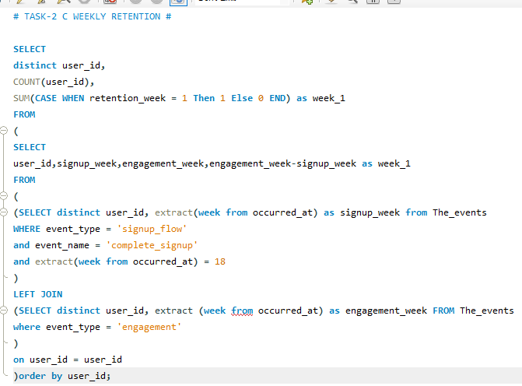
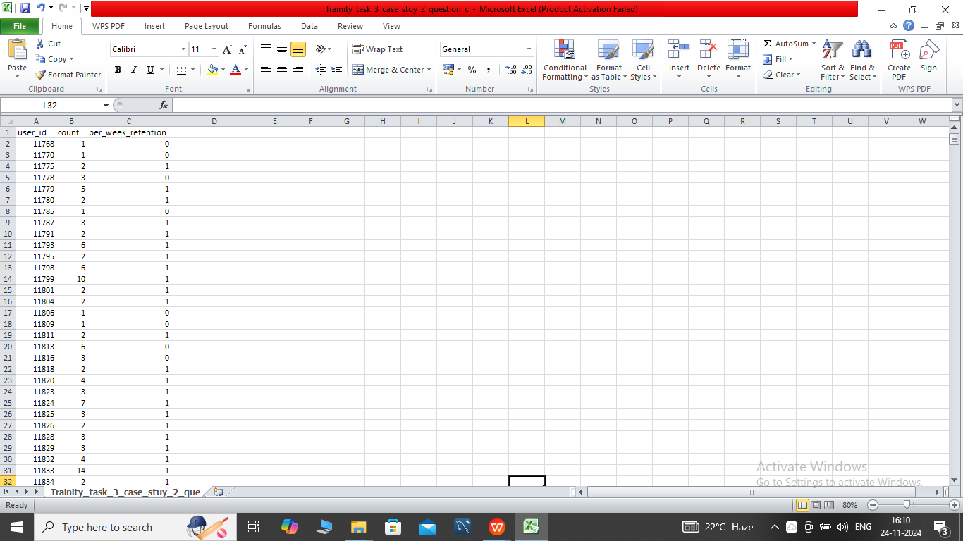
Query & Result:- There are total 4680 users data, I have only mention some of them in the table.

Slide 16
D. Weekly Engagement:- To measure the activeness of a user. Measuring if the user finds quality in a product/service weekly.
Your task: Calculate the weekly engagement per device?
Process:-
Firstly we will extract the year_num and week_num from the occurred_at column of the events table using the extract, year and week function.
Then we will select those rows where event_type = 'engagement’ using the WHERE clause.
Then by using the Group By and Order By function we will group and order the result on the basis of year_num, week_num and device.

Slide 17
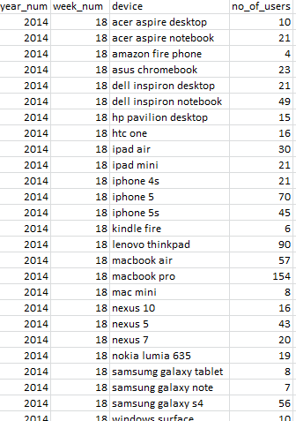
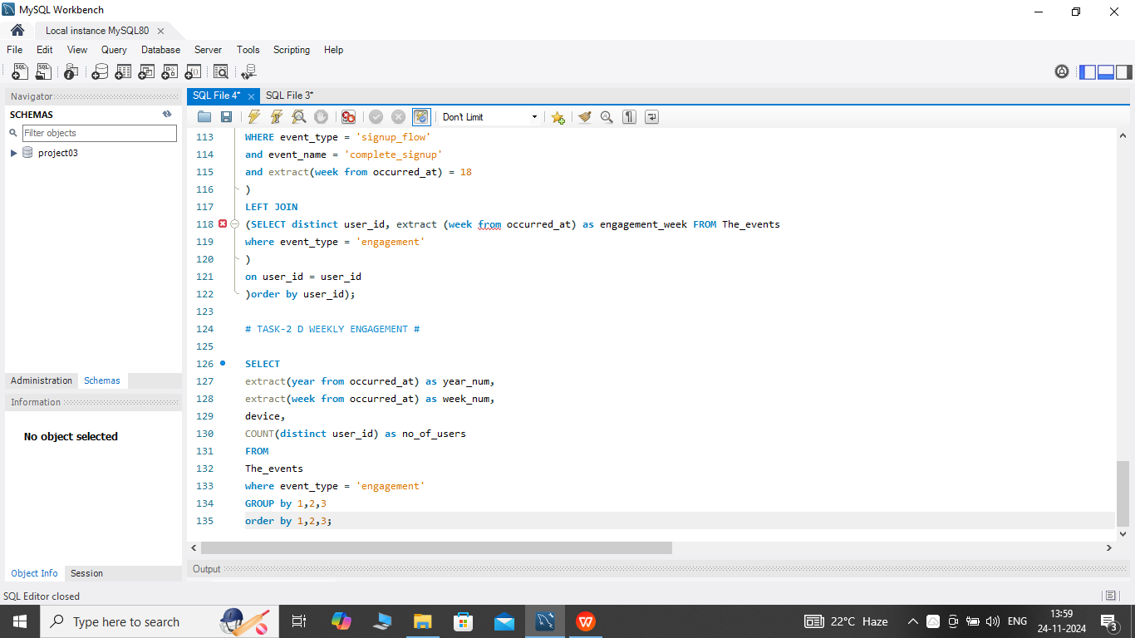
Query & Result:- There are total 468 users data, I have only mention some of them in the table.

Slide 18
E. Email Engagement:- Users engaging with the email service.
Your task: Calculate the email engagement metrics?
Process:-
We will first categorize the action on the basis of email_sent, email_openedand email_clicked using the CASE, WHEN, THEN functions.
Then we select the sum of category of email_opened divide by the sum of the category of email_sent and multiply the result by 100.0 and name is as email_opening_rate.
Then we select the sum of category of email_clicked divide by the sum of the category of email_sent and multiply the result by 100.0 and name is as email_clicking_rate.
Then we use comand email_sent = ('sent_weekly_digest','sent_reengagement_email’).
Then we use command email_opened = 'email_open’.
Lastly we use command email_clicked = 'email_clickthrough'.

Slide 19
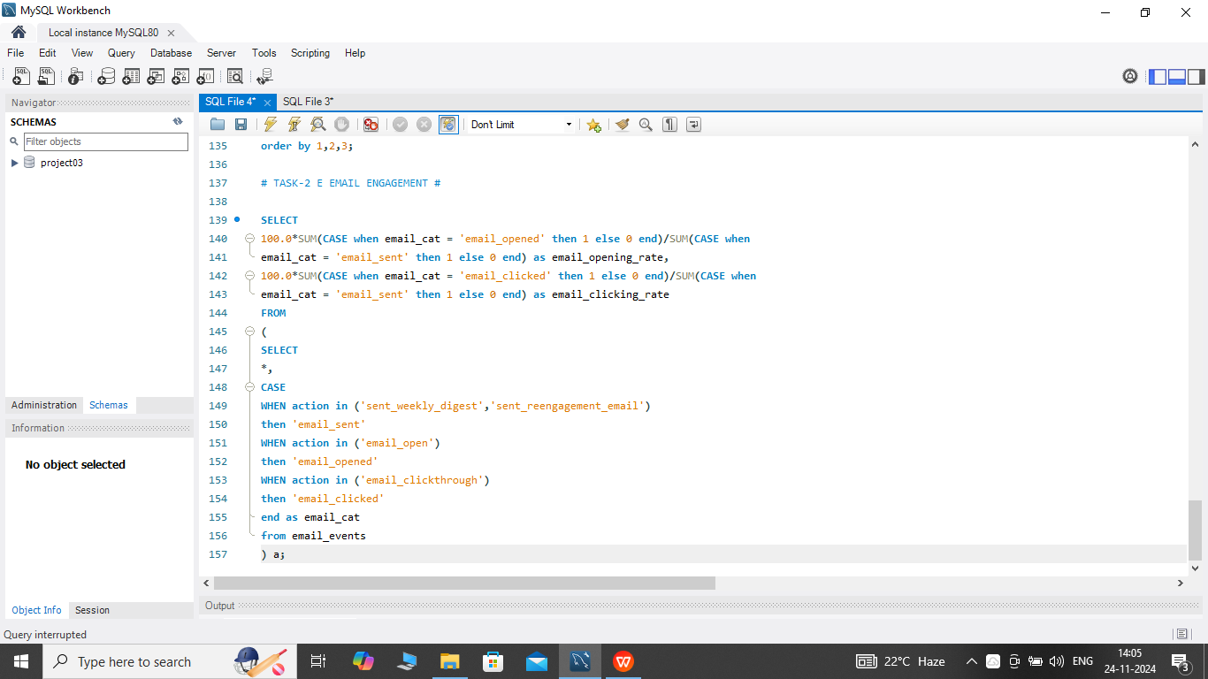
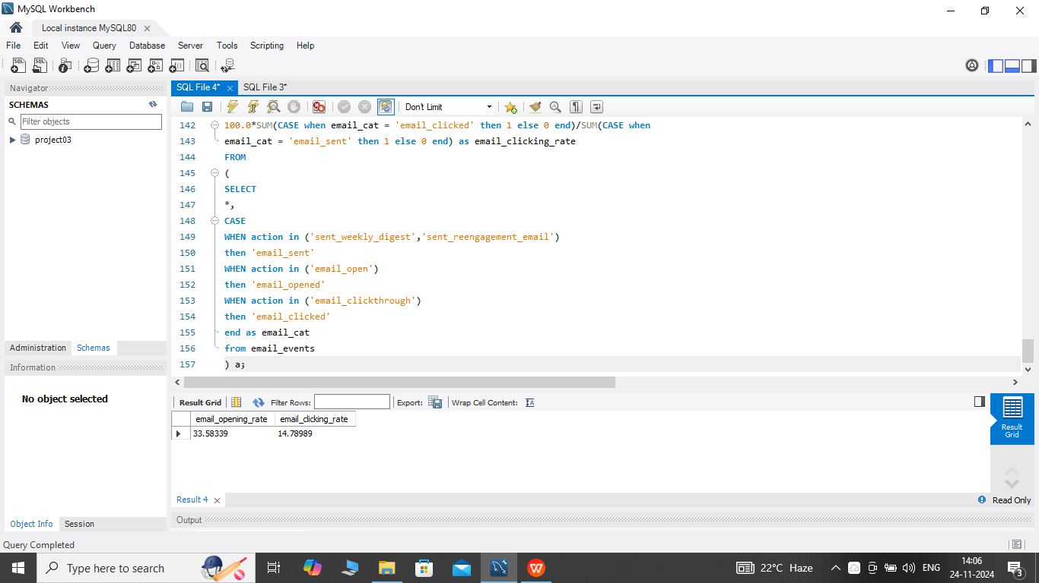
Query & Result:- Hence, The total email opening rate is 33.58% and total email clicking rate is 14.78%.

Slide 20
END

